Slide 1
Amazing Minds
… where kids love to learn!
www.myamazingminds.com

Slide 2
Our archaeological dig in Ancient Egypt

Slide 3
Mummies in Ancient Egypt

Slide 5
Color experimentation in
Let’s Experiment!

Slide 6
Expressing the Blues in Chicago

Slide 7
Analyzing our fingerprints like the FBI in Washington DC

Slide 8
Our Rocks and Minerals junior geologists!

Slide 9
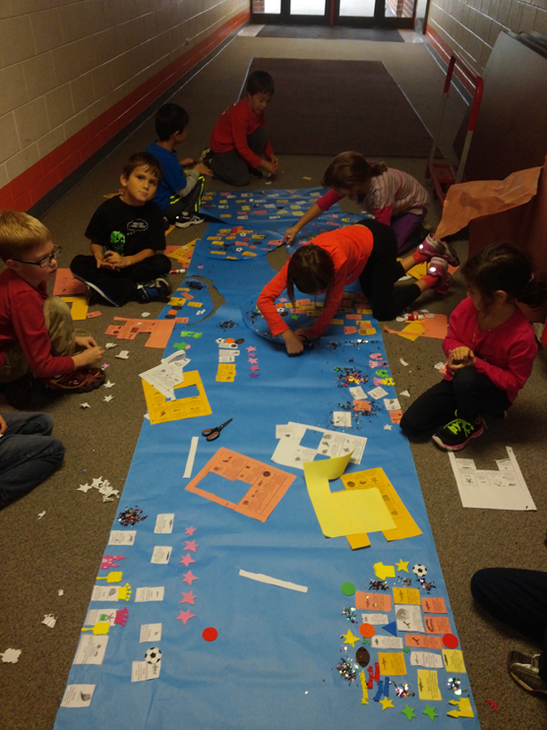
Our awesome Great Barrier Reef project from Australia

Slide 10
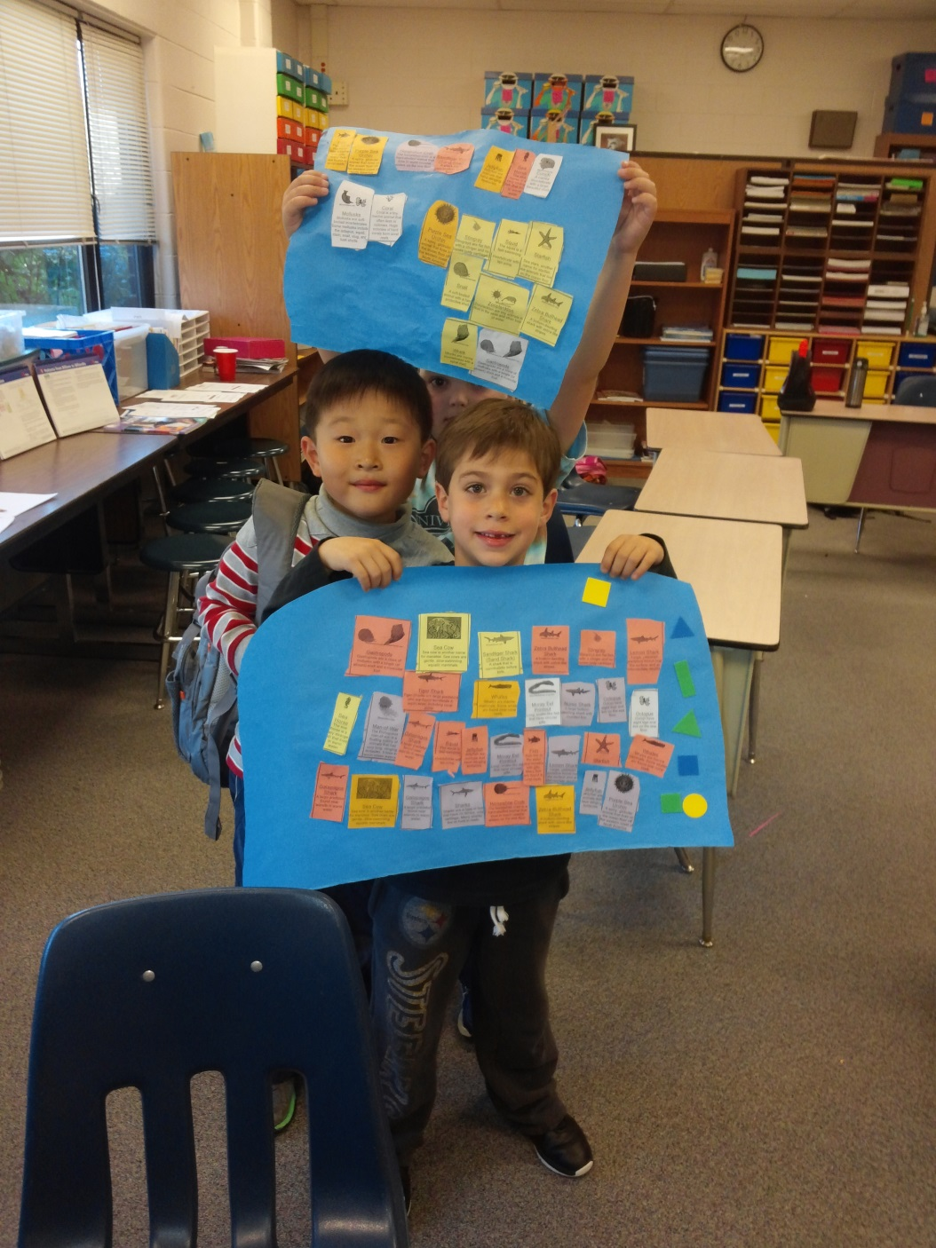

Slide 11
Pictures tell a story with hieroglyphics from Ancient Egypt

Slide 12
Observing germs under the microscope in Health and Safety

Slide 13
Native American sign language

Slide 16
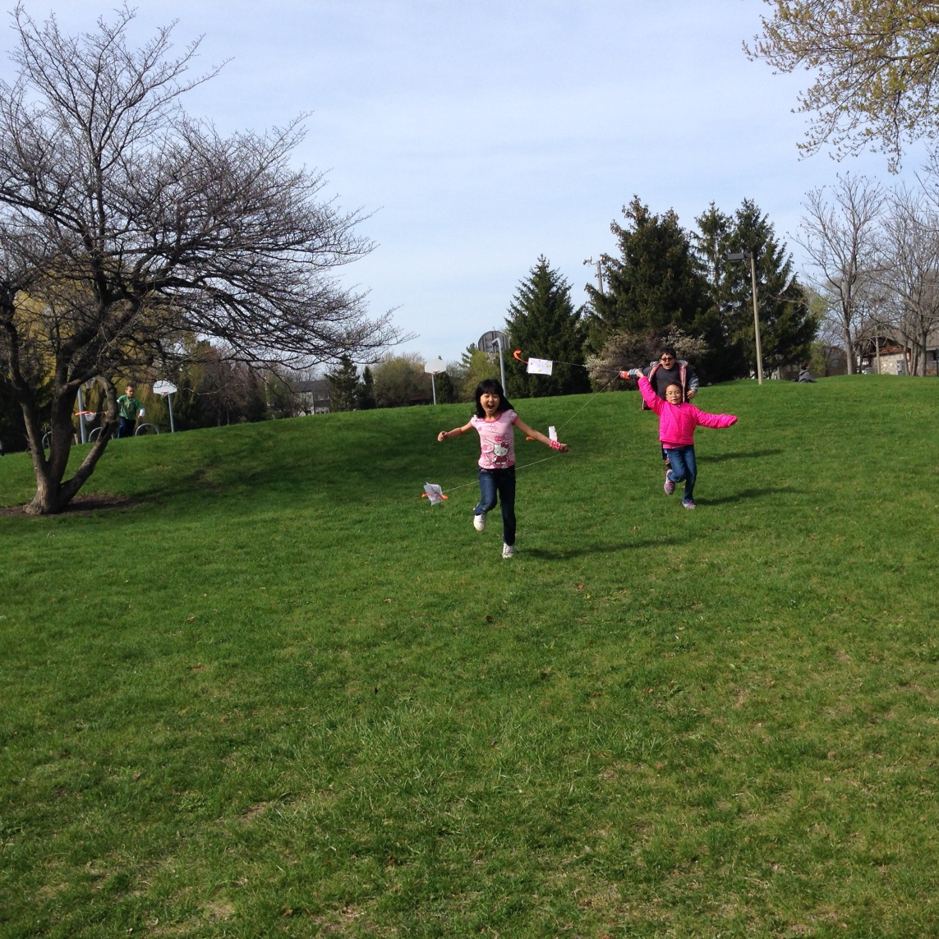
Flying our kites in Flight!

Slide 17
Sharks/Whales/Dolphins... our stuffed whales

Slide 19
Roaming the halls of the American Museum of Natural History in New York

Slide 20
Practicing our 3 R’s… Save the Earth tote bags!

Slide 21
Yes! We do birthday parties!

